Slide 1





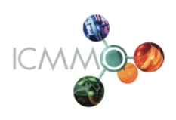
From Catalysis to Total Synthesis
Dr Solène Miaskiewicz
ECM Group Meeting
Friday, November 22nd 2019

Slide 2
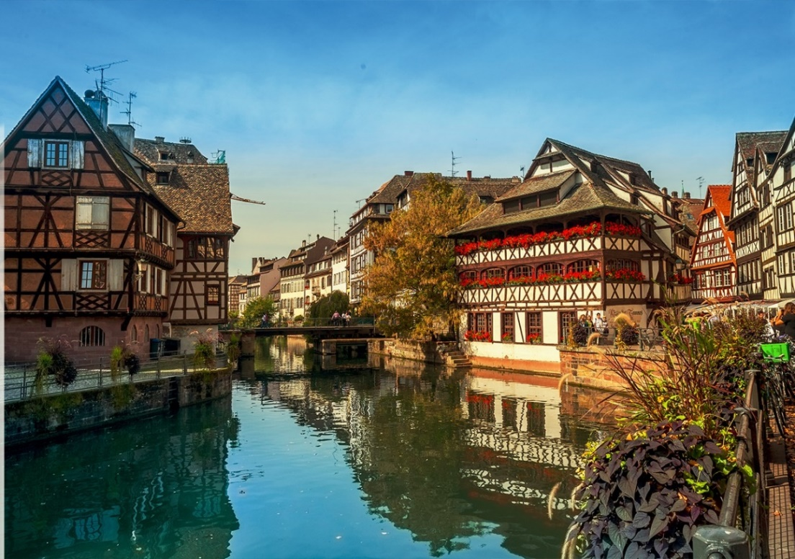
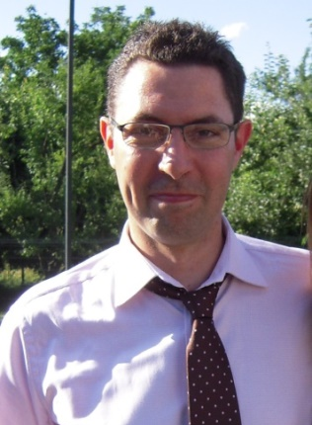
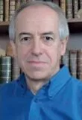

Strasbourg : PhD Thesis (2013 – 2017)
Professor Patrick Pale - LASYROC
Doctor Aurélien Blanc
Gold and azacycles
Towards the Total Synthesis
of Natural Products

Slide 3
Global Strategy
Hydroamination
Strained
azacycle
Triple bond
Deactivated amine
Sulfonyl protecting groups
Hard to deprotect
Nucleophilic enough
Total synthesis
Easily accessible
3

Slide 4
Bicyclic Ammonium Intermediate
Electrophilic C
Electrophilic C
Electrophilic S
Goal : Selective Nucleophilic Addition

Slide 5
Towards pyrrolin-4-ones
Alcohols
74 %
73 %
R = Alkyl
74% - 84%
83 %
89 %
81 %
94 %
Indoles
Phenol
R = Me
R = H
68 %
50 %
49 %
48 %
41 %
5

Slide 6
Azabicycles Synthesis
C-selective nucleophile
Pyrrolin-4-ones
= ROH
Indoles
Electrophilic C
Electrophilic S
?
S-selective nucleophile
Azabicycles

Slide 7
S-selective nucleophile
With Boris Gaillard
& Arno Lalaut
Optimal conditions
70 %
65 %
81 %
63 %
71 %
89 %
83 %
7

Slide 8
Internal nucleophile generation
External
Azabicycles
Internal
Pyrrolizidines
Indolizidines
?

Slide 9
Indolizidines and pyrrolizidines
n = 1
n = 2
68 %
88 %
No nucleophile
62 %
80 %
Sulfonyl group migration
98 %
79 %
80 %
70 %
Substrates synthesis: Sirindil, F. et al. Tetrahedron 2017, 73, 5096.

Slide 10
Synthetic applications: Rhazinal
Pd-catalyzed cross-coupling
55 %
Rhazinal total synthesis*
*by Dr Fatih Sirindil Org. Lett. 2019, 21, 5542

Slide 11
Synthetic applications: NP25302
NP25302
Formal synthesis
*Stevens, K. et al. Org. Lett. 2011, 13, 5964.

Slide 12
Last electrophilic position
Miaskiewicz, S. et al. Org. Lett. 2016, 18, 844.
Pertschi, R. et al. Synthesis 2017, 49, 4151.
Miaskiewicz, S. et al. Angew. Chem., Int. Ed. 2016, 55, 9088.

Slide 13
Towards Azepine derivatives
With Dr Nicolas Kern
& Dr Romain Pertschi
Proposed mechanism
Without any protic
nucleophile
Unpublished results

Slide 14
PhD Thesis Summary

Slide 15

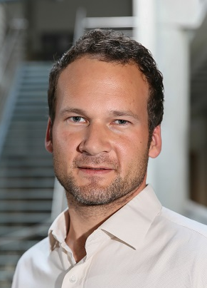

1st Postdoc – Organocatalysis
1,3,2-Diazaphospholenes
In Asymetric Synthesis
Lausanne (EPFL, Switzerland): Post-doc (2017-2018)
Professor Nicolai Cramer - LCSA

Slide 16
1,3,2-Diazaphospholenes
Secondary
Phosphines
1,3,2-Diazaphospholenes
(DAPs)
2000
Gudat¹
2006
Gudat²
2014-2015
Kinjo^{3,4}
2017
Speed⁵, Kinjo⁶
Weak acids
Hydride
donors
Stoichiometric
1,4-reduction
DAP regeneration
Catalytic
1,4-reduction
Asymmetric
Version
Gudat, D. et al. Angew. Chem. Int. Ed. 2000, 39, 3084
Gudat, D. et al. J. Am. Chem. Soc. 2006, 128, 3946
Kinjo, R. et al. Angew. Chem. Int. Ed. 2014, 53, 3342
Kinjo, R. et al. Angew. Chem. Int. Ed. 2015, 54, 190
Speed, A. W. H. et al. Angew. Chem. Int. Ed. 2017, 56, 6268
Kinjo, R. et al. ACS Catal. 2017, 7, 5814

Slide 17
Chiral 1,3,2-Diazaphospholenes
Dr Pavel Donets
General Idea
Preliminary results
2nd generation

Slide 18
1,4-reduction – Scope
With John Reed
A
Acyl pyrroles
Limitations
Ketones

Slide 19
Proposed mechanism
σ-bond
metathesis
Hydrolysis
Addition
Interconversion ?

Slide 20
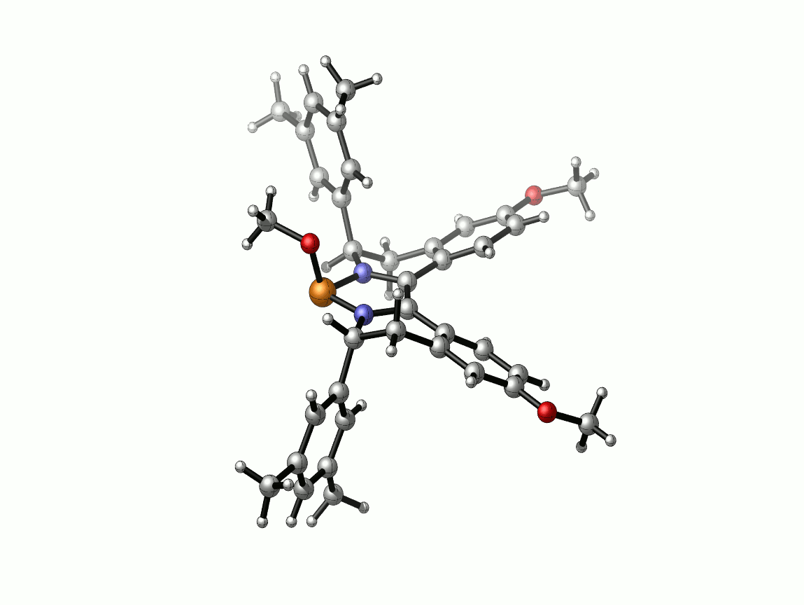
Asymmetric induction origin
RX pre-catalyst structure
Tunable steric
hindrance
Favored
approach
Rigid structure

Slide 21
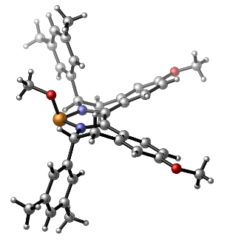
Summary and Perspectives
New family of chiral DAPs
Enantioselective 1,4-reduction
14 derivatives
P-enolates as reactive intermediates
Miaskiewicz, S. et al. Angew. Chem., Int. Ed. 2018, 57, 4039.
Reed, J. et al. Angew. Chem., Int. Ed. 2019, 58, 8893.
Imine reduction: Speed, A. W. H. Angew. Chem., Int. Ed. 2017, 56, 16660.

Slide 22
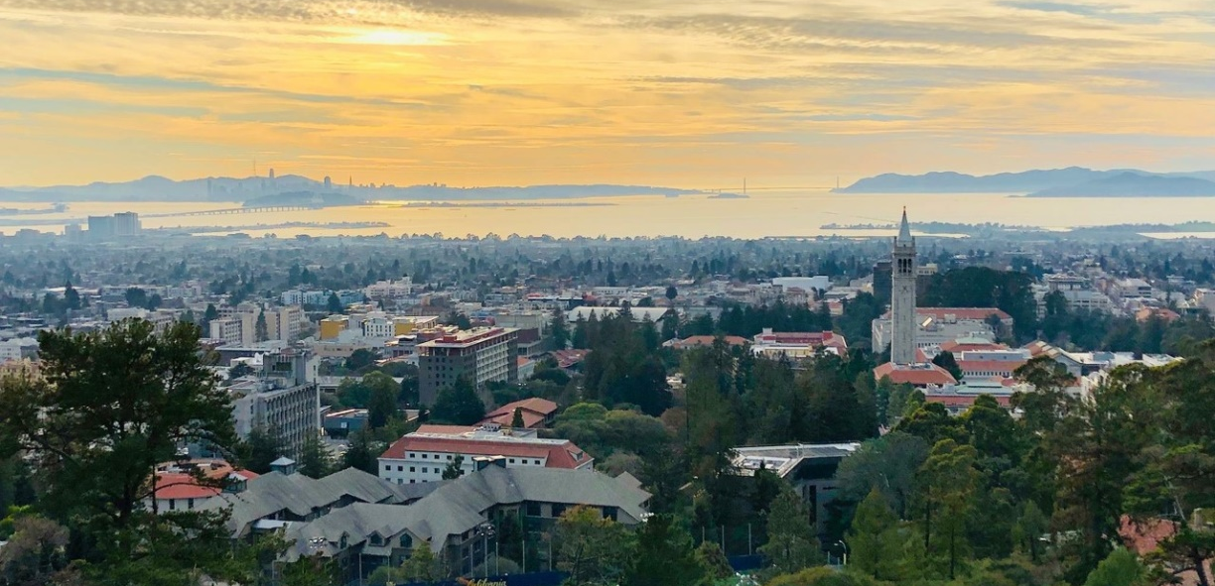
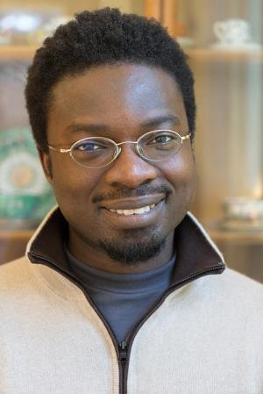
2nd Postdoc – Total Synthesis
of Terpenoids from Carvone
University of California, Berkeley Post-doc (2018-2019)
Professor Richmond Sarpong

Slide 23

Total Synthesis from Carvone
Both enantiomers
Cheap
Several functional handles
For reviews on carvone in total synthesis: a) Maimone, T. J. et al. Chem. Rev. 2017, 117, 11753
b) Hagiwara H. Nat. Prod. Commun. 2016, 11, 1391
Notes:
Ajouter littérature, maybe Maimone

Slide 24
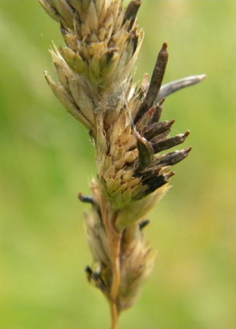
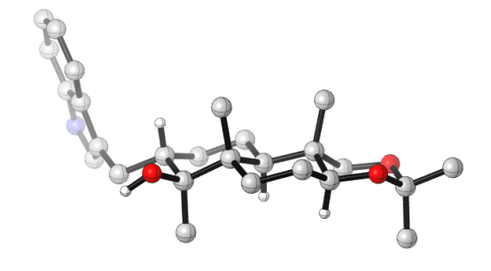

Paspaline Retrosynthesis
Indole diterpenoid
Less toxic insecticide
Claviceps paspali
Confidential, unpublished results
24

Slide 25
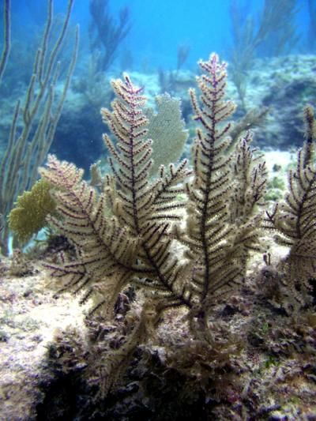

Ileabethoxazole Retrosynthesis
Benzoxazole derivative
Anti-tuberculosis activity
Pseudopterogorgia elisabethae
Confidential, unpublished results
25

Slide 26
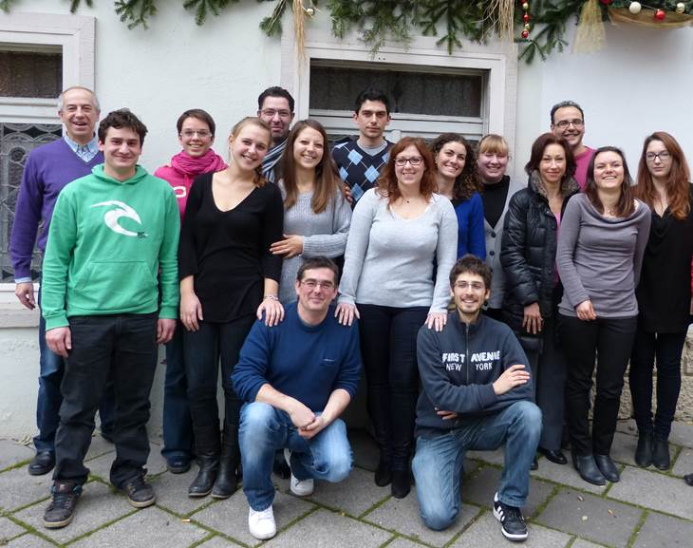



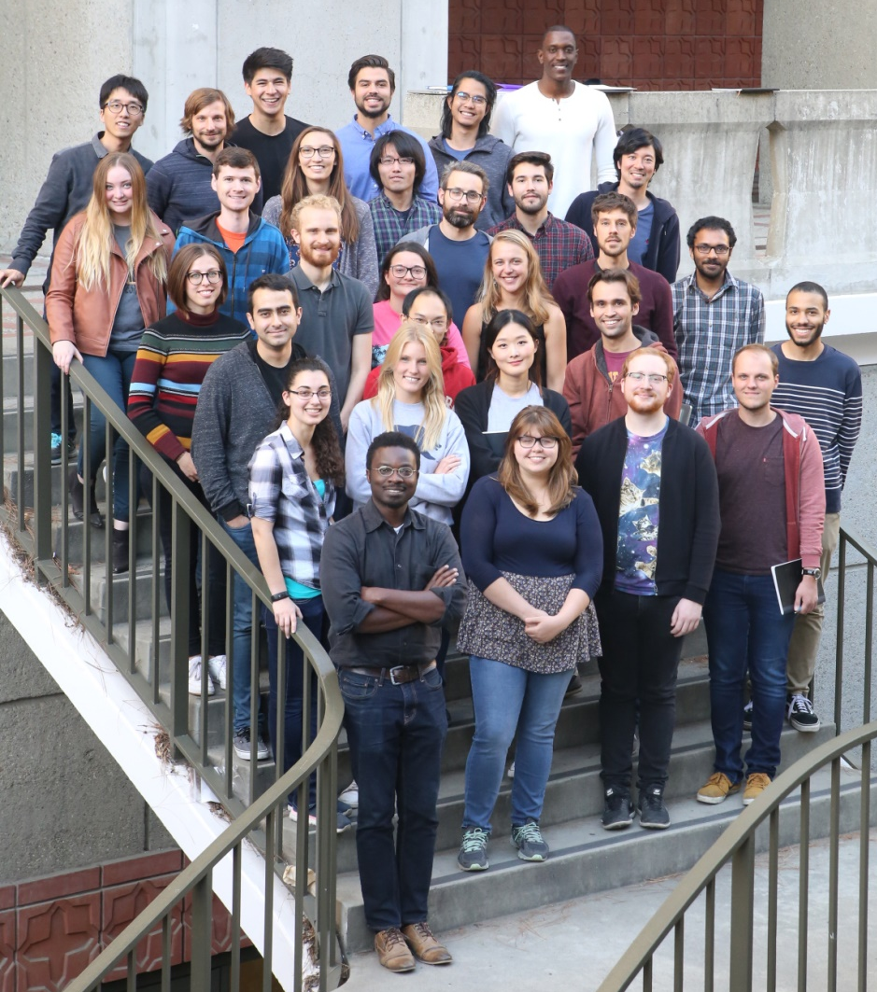
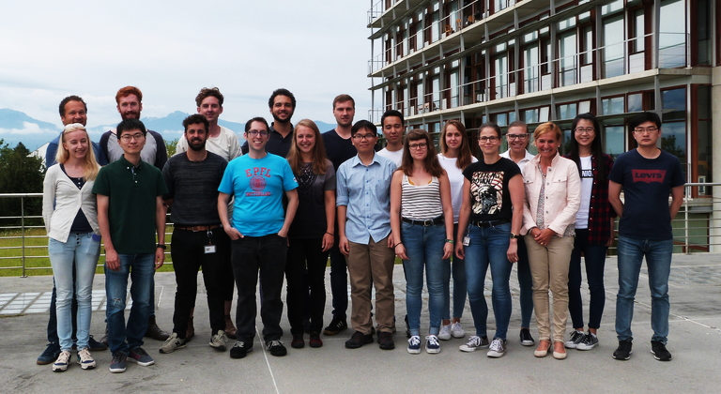

Slide 27
Synthetic progresses

Slide 28
Synthetic progresses

