Slide 1
Plateforme de l’ICMMO
Service Magnétométrie

Slide 2

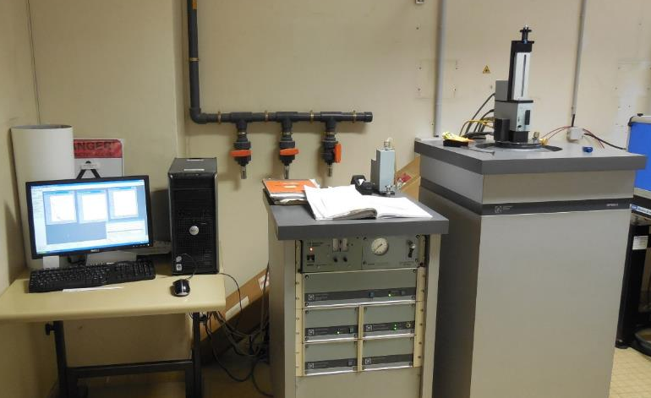
Plateforme Instrumentale de l’ICMMO
Service Magnétométrie
Université Paris-Sud
MPMS 5 (1996) :
  dc measurements,
  2-400K, (temperature sweep mode from 5 to 400K
  +/- 5T

Slide 3
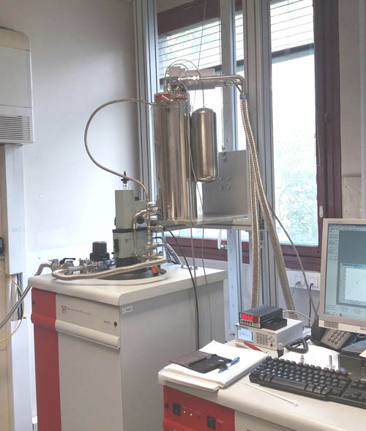
Plateforme Instrumentale de l’ICMMO
Service Magnétométrie
Université Paris-Sud
XL7 (2012) :
  2-400K, up to 7T, dc measurement,
  RSO,
  ac measurement (0.1-1500Hz),
  oven option: up to 800K (SP2M team)
  He reliquifier
  (Cryomech PT410)

Slide 4
Plateforme Instrumentale de l’ICMMO
Service Magnétométrie
Université Paris-Sud
Photomagnetic measurements:
UV/Vis or Vis/IR Fiberoptic Sample Holder

Slide 5
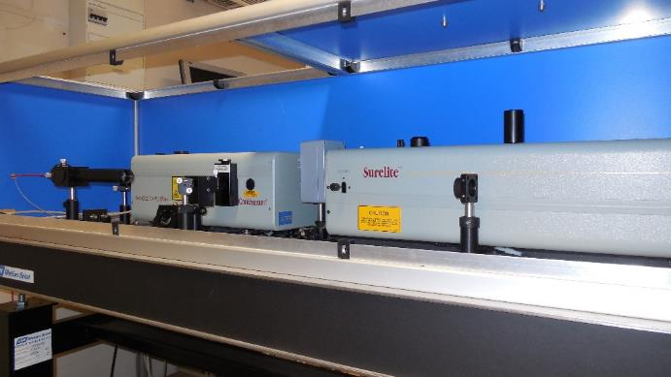
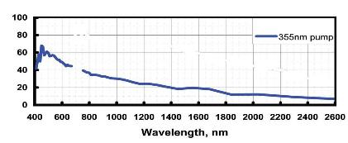
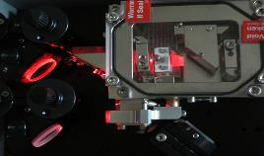
Plateforme Instrumentale de l’ICMMO
Service Magnétométrie
Université Paris-Sud
Lightning sources:
Pulsed Laser
Surelite Continuum
355nm +
OPO (410-1600 nm)
20 mW/cm² on the sample
_{« Idler »}
_{λ > 710 nm}
_{Cristal de BBO}
_{(β BaB2O4)}
_{Fiber coupling}
_{Source}
_{λ = 355 nm}
_{« Signal »}
_{400< λ < 710 nm}
_{Source}
_{λ = 355 nm}

Slide 6
Plateforme Instrumentale de l’ICMMO
Service Magnétométrie
Université Paris-Sud
Continuous Wave Sources:
Laser Diode (100mW max) : 405, 473, 532, 635 nm
Low-power diode (5 mW) 1290-1330 nm
LED (50 mW max) : 365, 375, 385, 505, 590, 850 nm

Slide 7
Plateforme Instrumentale de l’ICMMO
Service Magnétométrie
Université Paris-Sud
Area of competence :
Molecular Complexes
(a) Temperature dependence of χ_{M}T for compound 1ClO₄: (O) experimental data, solid line in red shows the simulation obtained with the isotropic Hamiltonian (fitting in the range 300−50 K), solid line in blue corresponds to the best fit including a local zero-field splitting parameter D (fitting in the range 300−2 K). (b) Magnetization vs H/T curves recorded at 2, 4, 6, and 10 K. Solid lines correspond to the curves determined using the parameters deduced from the χ_{M}T = f(T) curve.
Complexes moléculairesTrinuclear Manganese Complexes of Unsymmetrical Polypodal Diamino N3O3 Ligands with an Unusual [Mn3(μ-OR)4]5+ Triangular
Core: Synthesis, Characterization, and Catalase Activity, Inorg. Chem. 2014, 53, 2545−2553

Slide 8
Plateforme Instrumentale de l’ICMMO
Service Magnétométrie
Université Paris-Sud
Area of competence :
Single Molecule Magnet
ac susceptibility data for complexes 1 (a and b) and 2 (c and d). Plots of χ′ (a and c) and χ″ (b and d) versus temperature at different wave frequencies under a dc field (H = 1000 Oe).
Cole−Cole plots obtained for complexes 1 (a) and 2 (b). The solid lines represent the fit obtained with a generalized Debye model.
Perspective showing the distorted bicapped square-antiprismatic geometries of the central dysprosium(III) ion for 1 (a and b) and 2 (c and d).
Structural and Electronic Dependence of the Single-Molecule-Magnet Behavior of Dysprosium(III) Complexes, Inorg. Chem. 2014, 53, 2598−2605

Slide 9
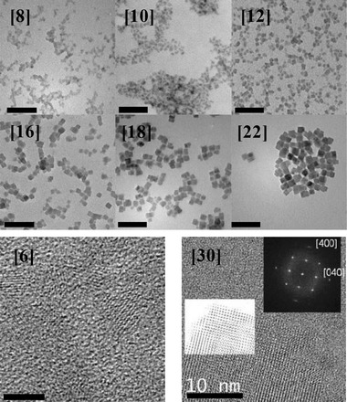
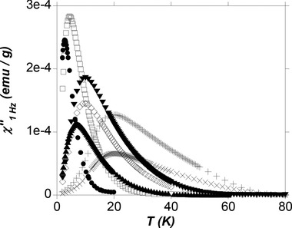
Plateforme Instrumentale de l’ICMMO
Service Magnétométrie
Université Paris-Sud
Area of competence :
Nanoparticules
TEM images of the nanoparticles [8], [10], [12], [16], [18] and [22] embedded in DODA+ (top, scale bar: 100 nm) and HRTEM images of the nanoparticles [6] (bottom left, scale bar: 5 nm) and [30] (bottom right, insert: electronic diffraction pattern).
Out-of-phase component, χ″, of the magnetic susceptibility at 1 Hz for the highly diluted samples [6_dil] (●), [8_dil] (◻), [10_dil] (▴), [12_dil] (⋄), [16_dil] (▾), [18_dil] (+) and [22_dil] (×).
Magnetization Reversal in CsNi^{II}Cr^{III}(CN)₆ Coordination Nanoparticles: Unravelling Surface Anisotropy and Dipolar Interaction Effects, Adv. Funct. Mater. 2014, 24, 5402–5411

Slide 10
Plateforme Instrumentale de l’ICMMO
Service Magnétométrie
Université Paris-Sud
Area of competence :
Spin Convertion / LIESST effect
Magnetic measurement of the Fe(mepy)₃tren](PF₆)₂·C₇H₈·C₂H₃N sample performed with a sweeping rate at 0.3 K min⁻¹: on cooling (blue), upon irradiation at 10 K with λ = 532 nm (black) and upon heating in the dark after reaching the photostationary state at 10 K.
Molecular structure of the [Fe(mepy)₃tren]²⁺ cation at 10 K
HS-to-LS relaxation curves performed with magnetization measurements at different temperatures (○), along with their modelization in the mean-field approximation (-).
Light-induced excited spin state trapping effect on [Fe(mepy)₃tren](PF₆)₂ solvated crystals. Dalton Trans., 2014, 43, 1063–1071

Slide 11
Plateforme Instrumentale de l’ICMMO
Service Magnétométrie
Université Paris-Sud
Area of competence :
LIESST Effect (2)
View of the cyanide-bridged {Fe^{III}₂Fe^{II}₂} square unit with the atom labelling for the metal environments. The hydrogen atoms are omitted for clarity. C: gray, N: blue, O: red, B: pale blue, Fe^{III}: yellow, Fe^{II}: orange
Magnetization vs. irradiation time of a dehydrated sample of 1 at different Wavelengths (7 mW/cm2).
Photomagnetic effect in a cyanide-bridged mixed-valence {Fe^{II}₂Fe^{III}₂} molecular square, Chem. Commun., 2012, 48, 5653–5655

Slide 12
Plateforme Instrumentale de l’ICMMO
Service Magnétométrie
Université Paris-Sud
Area of competence :
Molecular-scale devices
CoFe PBAs of chemical formula C_{x}Co₄[Fe(CN)₆]_{(8 + x)/3}·H₂O (C is an alkali cation) is well tuned, they are composed of Co^{III}(low spin, LS) and Fe^{II}(LS) diamagnetic ions at low temperature. Irradiation in the visible range induces the Co^{III}(LS)Fe^{II}(LS) → Co^{II}(high spin, HS)Fe^{III}(LS) electron transfer.
Temperature dependence of the magnetization under an applied field of 30 000 Oe of B) the PBA-free nanoperforated titanium oxide film coated on a gold layer and D) the nanocomposite coated on a gold layer before irradiation (white square) and after irradiation (black circle). A NiO antiferromagnetic thin pellet was added to the films in order to optimize the signal to noise ratio.
Tailor-made Nanometer-scale Patterns of Photo-switchable Prussian Blue Analogues, Adv. Mater. 2010, 22, 3992–3996

Slide 13
Plateforme Instrumentale de l’ICMMO
Service Magnétométrie
Université Paris-Sud
Area of competence :
Measurement of molecular networks on surfaces
Growth of NiCr films on Ni0 anchoring sites. SGS were performed on the Ni0 anchoring sites that form a relatively flat monolayer on a Si(100) substrate. We carried out SGS by immersing alternatively the functionalized substrate in an aqueous solution of [Cr(CN)₆]³⁻ (steps Cr1, Cr2,…Crn) and in a methanolic solution of Ni(H₂O)₆ ²⁺
NiCr SGS (6 cycles): a) Evolution of the intensity of the infrared asymmetric vibration band of cyanide at each step from the step Ni1 to Ni6 and corresponding peak area. b) AFM image and size distributions of the objects at the step Ni6. c) M = f(T) curves at H = 100 Oe for a bare silicon wafer (left) and at the step Ni6 of NiCr SGS (right) – plain circles: ZFC, open circles: FC.
Cyanide-bridged NiCr and alternate NiFe–NiCr magnetic ultrathin films on functionalized Si(100) surface, Dalton Trans., 2012, 41, 4445–4450
Notes:
Interaction ferro entre le Ni et les Cr, et surement interaction ferro entre les plots (taille des plots de 3nm => Tb < 5K ici Tb = 8K)

