Slide 2
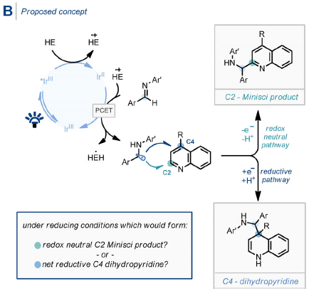
Minisci reaction
F. Minisci, R. Galli, M. Cecere, V. Malatesta, T. Caronna, Tetrahedron Lett. 1968, 9, 5609

Slide 4
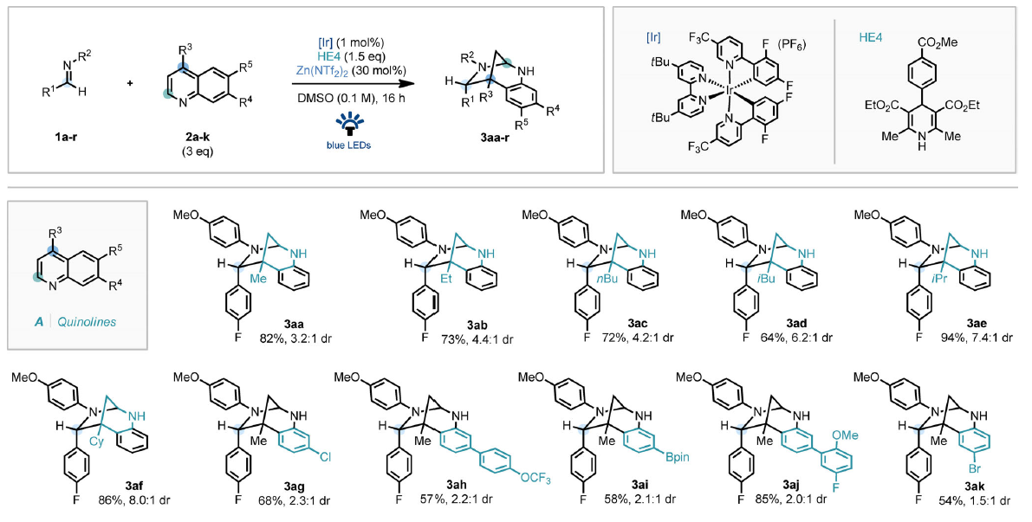
Scope of the reaction

Slide 5
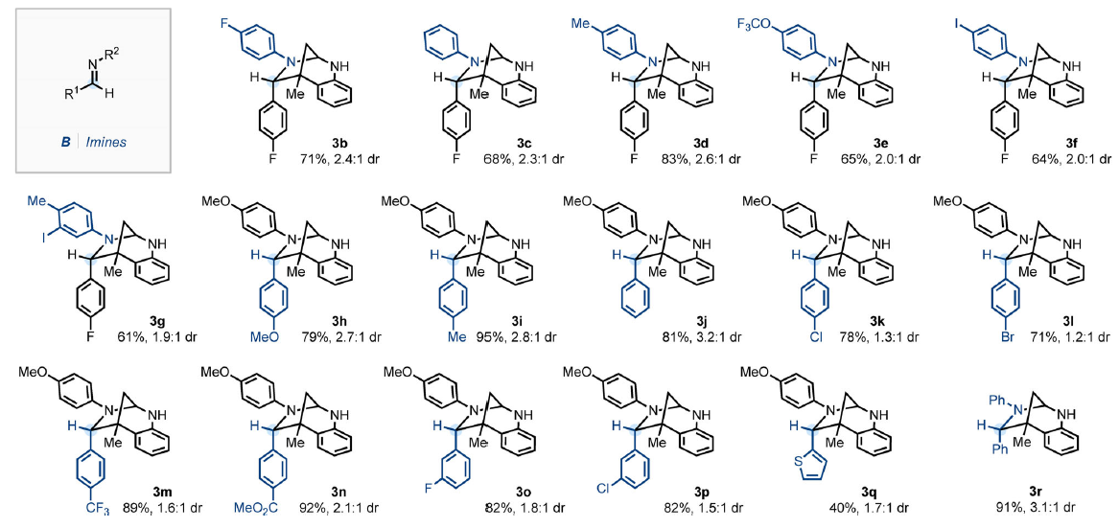
Scope of the reaction

Slide 6
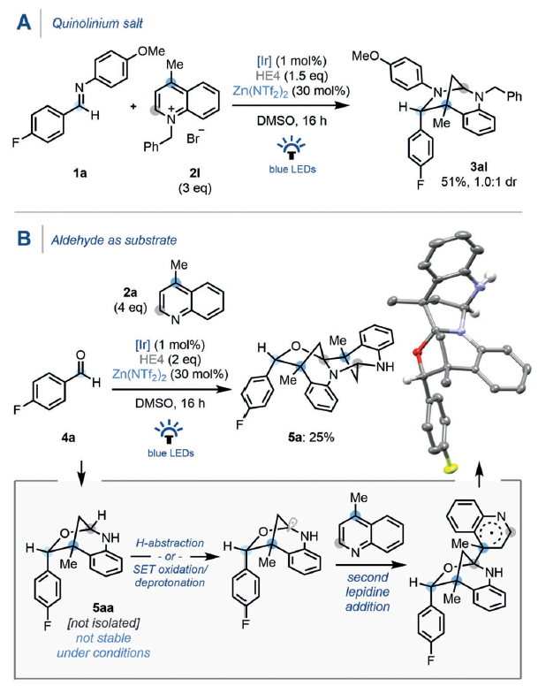
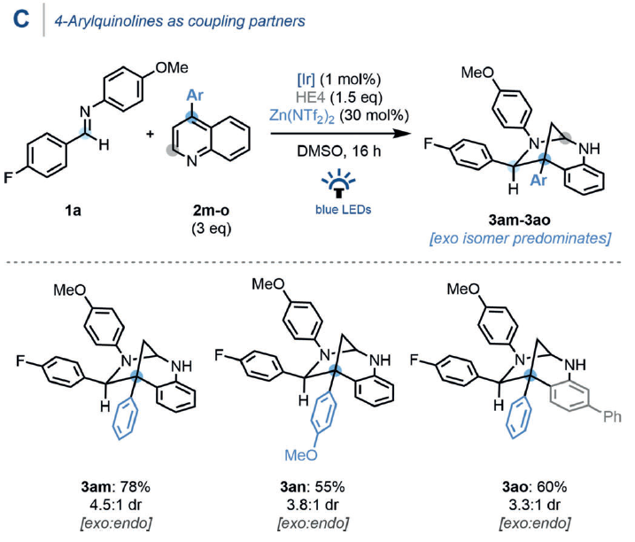
Further experiments

Slide 7
Mechanistic studies – Determination of the active radical species

Slide 8
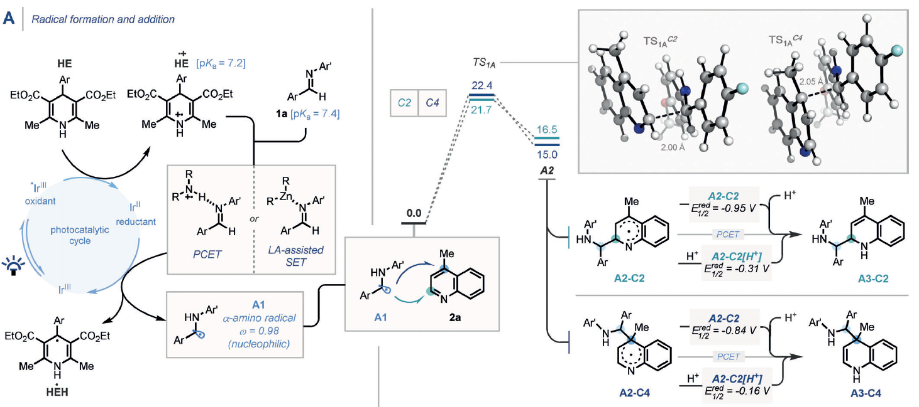
Mechanistic studies – C2/C4 selectivity

Slide 9
Mechanistic studies – C2/C4 selectivity

Slide 10
Mechanistic studies – Diastereoselectivity

