Slide 1
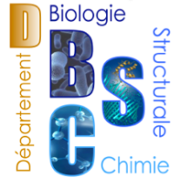
Synthesis of exotic chemiluminescent imidazolone-bearing heterocycles
Glwadys GAGNOT
ICMMO Group Meeting – 14/02/2020
PhD Supervisor: Dr Yves L. JANIN

Slide 2
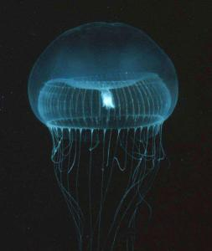
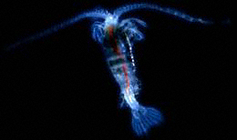
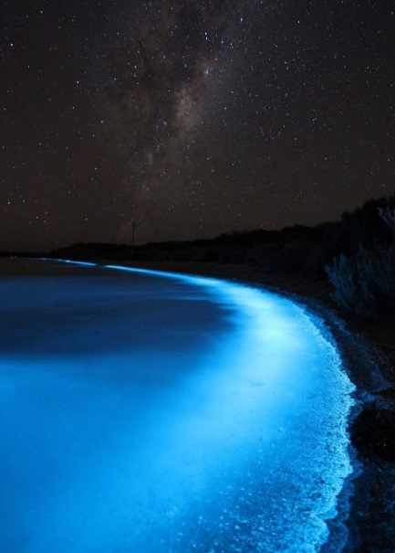
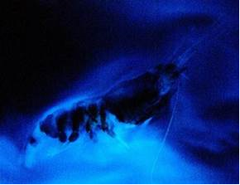
Natural bioluminescence
Dinoflagellates
(Hasting and Sweeney, 1957)
Oplophorus gracilirostris
(Inoue and Kakoi, 1976)
Aequorea victoria
(Harvey, 1921 and Shimomura, 1995)
Gaussia princeps
(Barnes, 1972)
Shimomura, O. Bioluminescence: Chemical Principles and Methods, Revised Edition; World Scientific: Singapore, 2012.
Notes:
Natural bioluminescence, very commun in oceans
Substrate + enzyme = bioluminescence
Substrate + base = chemiluminescence

Slide 3
Our synthetic pathway
How to easily produce coelenterazine analogues?
More than 150 new analogues synthesized!
Janin, Y. L. et al. Patent EP 3395803 / WO 2018197727
Coutant, E. P. et al. Org. Biomol. Chem. 2019, 17, 3709-3713.
Notes:
Reporting system in life science
Structure-bioluminescence relationship
eight steps, a hundred and fifty new analogues of coelenterazine

Slide 4
Recent achievements
Intense signal
Long-lasting signal
Commercial substrate
Natural substrate
Notes:
This enzymatic reaction

Slide 5
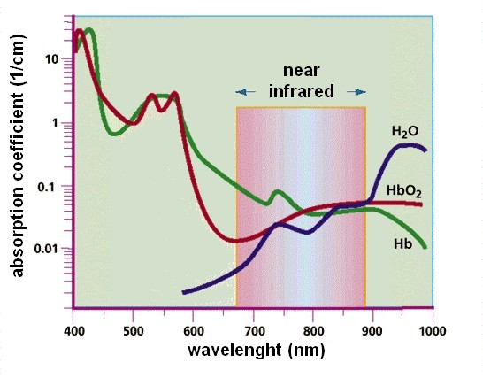
Next: red-shifted signal?
Intense signal
Long-lasting signal
Red-shifted signal for in vivo applications
Adapted from Weissleder, 2001, Nat. Biotech.
Notes:
REQUIERING
Depending on the application, the reporting system (that is to say the luciferin/luciferase system) must have different properties:
Intense bioluminescent signal… is widely appreciated
Long lasting signal (for high-throughput screening)
In nature, these kind of bioluminescent systems have been specialized to emit blue light, which is the most fitted for underwater use. However, for our biological applications, a red-hifted signal would be much more suitable, as red light is able to pass through mammalian tissues
So, the goal of my project was : how can we adapt a naturally « blue » bioluminescent system to obtain red light ?

Slide 6
Red-shifted imidazopyrazinones: State of the art
Current strategy: electron-rich luciferins with enhanced potential of electron delocalization

Slide 7
Our approach
Electron enriched analogues
Enhanced electronic delocalization

Slide 8
Oxygenated bridged-cores

Slide 9
Oxygenated bridged-cores
12 steps, 4% overall yield

Slide 10
Fluorinated bridged-cores
11 steps, 4% overall yield
Notes:
the beginning includes a fluorinated-naphthalene that endergoes a Buchwald coupling (again, we do love this reaction) to produce the wanted amino-ester
we tried to directly perform the amidation/cyclisation as intended, but it appears that the electron poverty of the molecule is problem for direct ch-activation
So we decided to use a bromination and an amidation to allow us to prepare the piperazinone intermediate via pd coupling
Then, the usual synthesis led to the hydroxypyrazine and after some more steps to the wanted analogue

Slide 11
Isoquinoline-like cores
Using the previously described synthetic pathway…
9 steps, 4% overall yield

Slide 12
Quinoxaline-like cores
5 steps, 35% overall yield

Slide 13
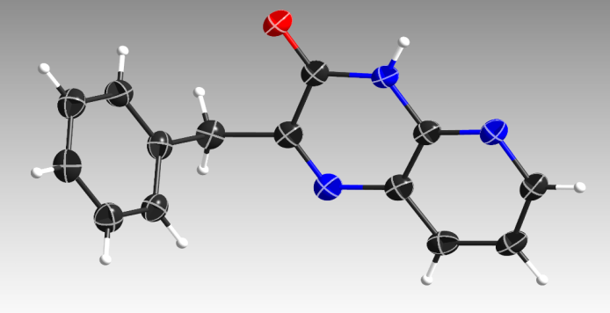
Quinoxaline-like cores
5 steps, 1% overall yield

Slide 14
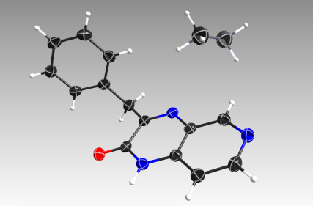
Imidazopyridopyrazinones
Notes:
Au final, parmi les 4 analogues possiblement synthétisables via cette voie de synthèse, seul un a pu être synthétisé

Slide 15
Chemiluminescence at 5mM
commercial substrate
natural substrate
commercial substrate

Slide 16
Chemiluminescence at 0,05 mM
Notes:
En ce qui concerne les autres analogues, nous avons commence par nous intéresser à leurs propriétés de chimiluminescence à faible concentration
Dans ces conditions, tous ont un maximum d’intensité pour une longueur d’onde d’environ 470 nm sauf un analogue

Slide 17
Current project:
Electrochemistry
Saleh, N., Voituriez, A. J. Org. Chem. 2016, 81, 4371

